Slide 1
HOUSE PRICE PREDICTION, HYDERABAD -Asha Jyothi Kapu

Slide 2
ABSTRACT
House Price Prediction Is A Critical Aspect Of Real Estate, Providing Valuable Insights For Buyers, Sellers, And Investors. In 2024, The Methods Used To Forecast Housing Prices Have Evolved Significantly, Blending Traditional Techniques With Advanced Machine Learning.

Slide 3
EXISTING METHODS
1. Linear Regression
2. Multiple Linear Regression
3. Decision Trees
4. Random Forests
5. K-Nearest Neighbors (KNN)
6. Time Series Models (e.g., ARIMA)

Slide 4
Disadvantages:
Poor at handling imbalanced data or missing values.
Poor performance if important features are missing or data is not well-preprocessed.
No multicollinearity (independent features shouldn't be highly correlated).
Assumes homoscedasticity (constant variance of errors), which may not hold in real data.
Prone to overfitting, especially with deep trees.
Computationally expensive for large datasets (slow at prediction time).
Poor at handling imbalanced data or missing values.

Slide 5
PROPOSED METHODS
1. Data Preprocessing & Feature Engineering
2. Exploratory Data Analysis (EDA)
3. Linear Regression
4. Random Forests
5. Gradient Boosting (XGBoost/LightGBM)
6. CatBoost Regression
7. Stacking Regression

Slide 6
Advantages:
Handles categorical features automatically — no need for manual encoding.
Handles categorical features automatically — no need for manual encoding.
Handles categorical features automatically — no need for manual encoding.
Handles missing values, outliers, and scaling, improving model robustness.
Improves model performance by making data more meaningful.
Reduces noise and dimensionality, boosting accuracy and training speed.
Helps uncover patterns, outliers, and relationships in data.
Guides feature selection and model choice based on data insights.
Simple and fast to implement and train.
Works well for linearly correlated data.
Reduces overfitting by averaging many decision trees.
Handles non-linear relationships and high-dimensional data.
Handles both classification and regression well.
Extremely high accuracy and performance, often outperforming other models.

Slide 7
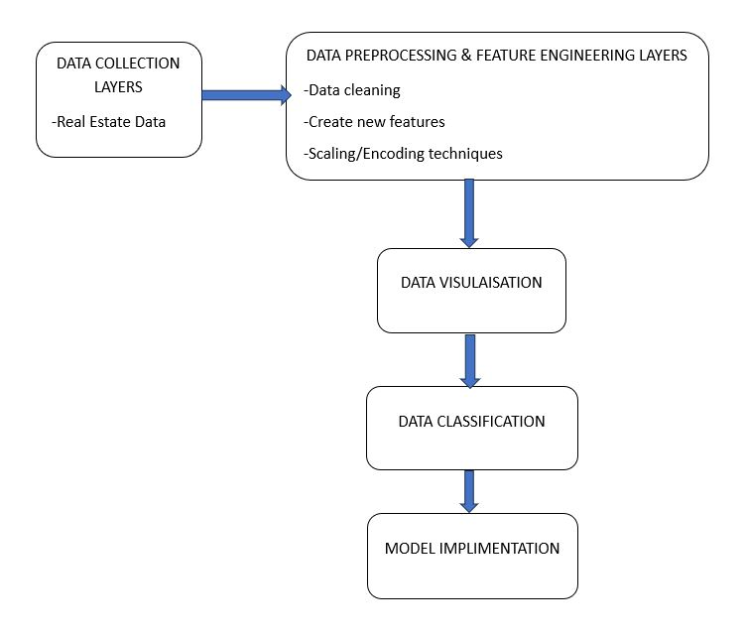
System Architecture

Slide 8
System Requirements
Software Requirements:
Operating System
Programming lang.
Libraries and Framework
Database
Web frameworks
Version Control
Hardware Requirements:
CPU -multi-core processor
RAM -Min 16GB
Storage -SSD (atleast 100GB)
Network -high speed internet connection

Slide 9
UML DIAGRAMS: 1. Use- Case Diagram 2. Data Flow Diagram 3. Class Diagram 4. Sequence Diagram 5. Activity Diagram

Slide 10
Technology/Domain Introduction:
The algorithms used in this analysis include: Linear Regression, Decision Tree Regressor, Random Forest Regressor, Gradient Boosting Regressor and XGBoost Regressor. To assess the performance of these models, I utilized the sci-kit learn Python library. Then evaluated the models using several performances metrics, which includes R-square, Mean Absolute Error (MAE), Mean Absolute Percentage Error (MAPE). These metrics provide valuable insights into the accuracy and effectiveness of the models in predicting house price.
Linear Regression
Random Forest
CatBoost Regression
Stacking Regression
XGB Regression

Slide 11
Programming Language Introduction:
For this project, the primary programming language used is Python. Python is widely regarded as the leading language for data science, machine learning, and House Price Prediction, Hyderbad applications due to its simplicity, extensive library support, and strong community. It offers an ideal balance between rapid development, powerful data handling capabilities, and support for deploying production-grade systems.
The advantages of using Python in this project include:
Rich Libraries for Machine Learning and Deep Learning
Robust Data Handling and Preprocessing
Real-Time Data Collection and Streaming
Model Deployment and API Development
Visualization Tools
Flexibility and Integration

Slide 12
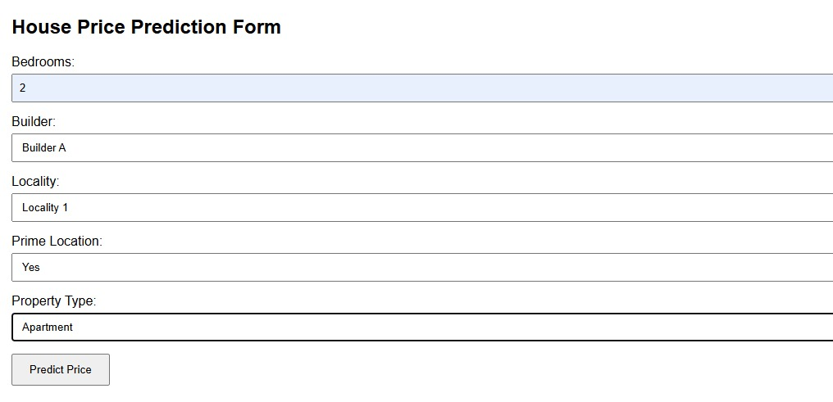
OUTPUT TEST CASES: Test-1:

Slide 13
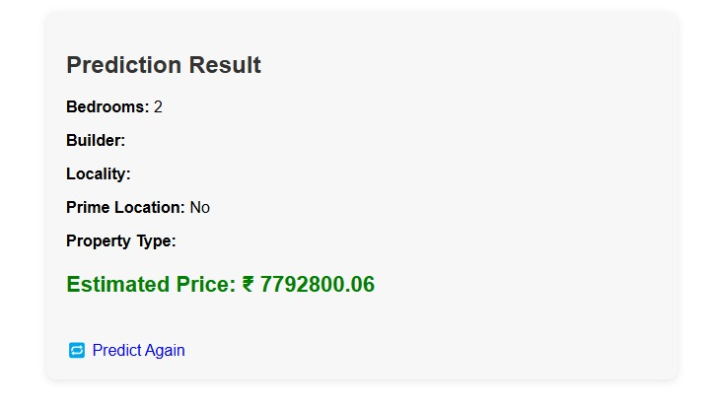
OUTPUT TEST CASES: result-1:

Slide 14
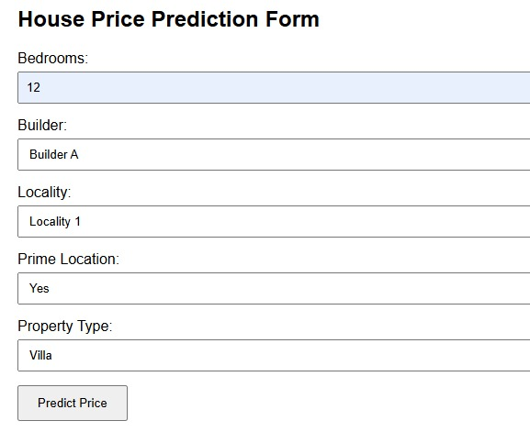
OUTPUT TEST CASES: Test-2:

Slide 15
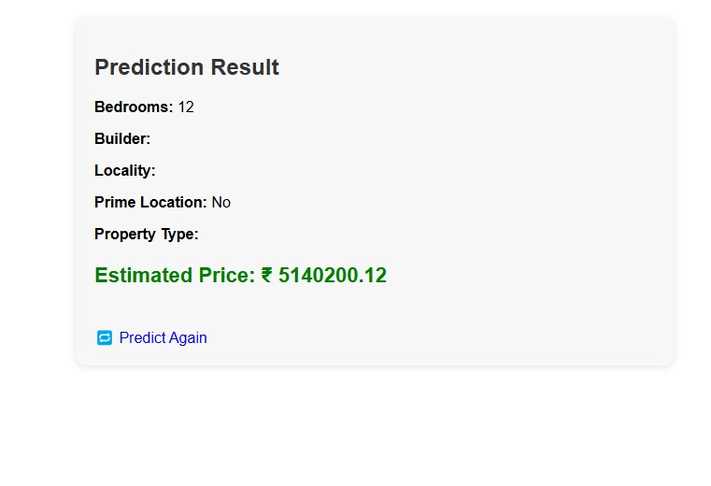
OUTPUT TEST CASES: result-2:

Slide 16
Conclusion:
I aimed to predict house property prices using various machine learning algorithms and compared them in terms of performance metrics. The machine learning algorithms includes Linear Regression, Random Forest Regression, Gradient Boosting Regression and XGB Regression. All these algorithms were trained on a dataset containing 2100 records. After evaluating the performance metrics of all these algorithms, it was observed that the "Linear Regression", "CatBoost Regressor", "Random Forest", "XGBoost Regressor", "Stacking Regressor” performed exceptionally well in terms of performance metrics, achieving the highest adjusted R-squared value of 0.999999999992362, the lowest MAE of 7.311904761952067 and MSE of 60.38928571549791 and RMSE of 7.771054350311669 surpassing the other models. The Stacking regressor has performed well followed by Stacking regressor with good results. For enhancement there is need of adding some more features which will change the house price prediction results.

Slide 17
References:
1. https://www.ijfmr.com/research-paper.php?id=1849
2. https://scholar.google.com/scholar?as_q=House+Price+Prediction+Using+Machine+Learning
+Via+Data+Analysis&as_occt=title&hl=en&as_sdt=0%2C31
3. https://sol.sbc.org.br/index.php/eniac/article/view/9300
4. https://scholar.google.com/scholar?as_q=House+price+prediction+based+on+machine+learning+and+deep+
learning+methods&as_occt=title&hl=en&as_sdt=0%2C31
5. https://scholar.google.com/scholar?as_q=House+Price+Prediction+with+Machine+ Learning&as_occt=title&hl=en&as_sdt=0%2C31

